Slide 1

Reuters Institute
Digital News Report
2025
Loss of influence for journalism?
Rise of alternative media and video formats
Platform shifts + disruption of search
Combatting news fatigue
New business models
June 17th 2025
Craig Robertson, Reuters Institute
@risj_oxford | #DNR25
@risj_oxford | #DNR25

Slide 2
Representing half the world’s population
97,000
6
Respondents
48
Continents
Markets
Notes:
This is our 14th Digital News report and this year we cover 48 markets, which represents our largest ever survey representing around half the world’s population

Slide 3
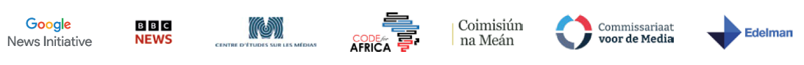





Methodology: Online poll conducted Jan/early Feb 2025
Country | Sample Size | Population | Internet Penetration
Europe
UK | 2,076 | 68m | 96%
Austria | 2,026 | 9m | 95%
Belgium | 2,046 | 11.7m | 95%
Bulgaria | 2,029 | 6.6m | 80%
Croatia | 2,092 | 4m | 83%
Czech Republic | 2,009 | 10.5m | 86%
Denmark | 2,013 | 5.9m | 100%
Finland | 2,015 | 5.5m | 94%
France | 2,015 | 65m | 87%
Germany | 2,047 | 83m | 94%
Greece | 2,010 | 10.3m | 85%
Hungary | 2,001 | 10m | 92%
Ireland | 2,000 | 5.1m | 97%
Italy | 2,008 | 59m | 87%
Netherlands | 2,020 | 17.7m | 97%
Norway | 2,031 | 5.5m | 99%
Country | Sample Size | Population | Internet Penetration
Poland | 2,015 | 40m | 86%
Portugal | 2,014 | 10.2m | 86%
Romania | 2,003 | 19.6m | 89%
Serbia | 2,010 | 7.1m | 85%
Slovakia | 2,013 | 5.7m | 90%
Spain | 2,014 | 48m | 95%
Sweden | 2,000 | 10.7m | 96%
Switzerland | 2,023 | 8.9m | 97%
Turkey | 2,002 | 86m | 87%
Americas
USA | 2,053 | 342m | 93%
Argentina | 2,014 | 46m | 89%
Brazil | 2,006 | 218m | 84%
Canada | 2,031 | 39m | 94%
Chile | 2,009 | 19.7m | 95%
Colombia | 2,013 | 52m | 77%
Mexico | 2,010 | 129m | 81%
Peru | 2,022 | 35m | 80%
Country | Sample Size | Population | Internet Penetration
Asia Pacific
Australia | 2,006 | 27m | 97%
Hong Kong | 2,004 | 7.5m | 96%
India | 2,044 | 1,442m | 56%
Indonesia | 2,028 | 280m | 69%
Japan | 2,000 | 123m | 87%
Malaysia | 2,063 | 35m | 98%
Philippines | 2,014 | 119m | 84%
Singapore | 2,014 | 6.1m | 94%
South Korea | 2,038 | 52m | 97%
Taiwan | 2,018 | 23m | 85%
Thailand | 2,003 | 72m | 90%
Africa
Kenya | 2,007 | 56m | 35%
Morocco | 2,012 | 38m | 91%
Nigeria | 2,044 | 229m | 39%
South Africa | 2,070 | 61m | 76%
Polling by
Supported by
Spanish translation by
Notes:
>>> A reminder of the methodology – which is based on online polling … and as such it will tend to underrepresent traditional news behaviours such as TV, print and radio when we talk about cross platform behaviour. It is also important to stress that some of the markets especially in Africa and India are representative of younger more educated, English- speaking groups so we try to bear in mind these differences. The survey was conducted on our behalf by YouGov on our behalf in January/early February 2025
We are grateful to the Google News Initiative which remains the main sponsor of the report but also to 18 other supporters including the BBC, NHK, Ringier International, code for Africa media regulators, industry organisations and a number of academic institutions around the world. We are grateful to Reuters for their sponsorship and for hosting us here again today, also to Edelman who remain a long term and valued partner.
I will now hand over to Nic Newman, lead author for a summary of some of the key findings

Slide 4
Traditional news media losing influence
Notes:
A key theme of this year’s report is evidence that traditional media is losing reach and influence to an alternative ecosystem that includes youtubers and podcasters. And this has been particularly evident in the United States

Slide 5









Proportion that access news sources weekly - USA
Further drop in TV and other traditional sources of news
TRUMP BUMP
(all boats rise)
SECOND
TRUMP BUMP?
(just social/video
up)
Social and video networks
above TV for first time
TV down 22pp
Online news sites
down 21pp
News podcasts (15%)
more than radio (13%)
15%
Print down 33pp
7%
AI news emerging
Q3. Which, if any, of the following have you used in the last week as a source of news? Base: Total sample in each year ≈ 2000. Note: No data for 2014. There was a sampling and weighting change from 2021 onwards.
Notes:
So this chart chart shows weekly reach for some of the main sources of news over time and we can see how television print and online news website are all trending down despite our poll taking place at around the time of the trump inauguration
>>> at the same time we can see an increase in the use of social and video networks as a source of news in the last year – overtaking TV for the first time .
>>>> Last time round when trump was elected all forms of media benefitted but >>>>this time round the surge has mainly been just in social and video networks
>>>And then on top of that we also see podcasts ahead of radio in the United STates and emerging use of AI chatbots for news. I should say that we added podcasts and chatbots to this question for the first time this year

Slide 6

Personalities/creators are becoming key news sources
Popularity of podcasters like Joe Rogan is seen as highlighting declining influence of traditional TV channels.
Proportion seeing each discussing or commenting on news in last week
Disproportionate with younger men
RIGHT-LEANING AUDIENCES
LEFT- LEANING AUDIENCES
Notes:
And linked to these trends we can also measure the name recognition now for a number of these personalities who distribute their content, not on TV, but exclusively via online platforms. In our survey 22% around a fifth of our sample say they saw Joe Rogan discussing or commenting on the news in the previous week - and if we look at his audience we can see that it is disproportionately made up of young men, the same audience that traditional media is increasingly struggling to reach. >>>> The other aspect of this is that the audience make up is largely partisan so the top five have mainly right leaning audiences,>>>> there are far fewer that have left leaning audiences including Brian Tyler Cohen and David Pakman

Slide 7
Is this happening elsewhere?
Notes:
Do obviously a big question is this just an American phenomenon or is it happening elsewhere

Slide 8






Reliance of social & video networks as a main source of news has increased across countries
US is joining a social first club that includes most Latin American and African countries + India, Philippines, Indonesia and Malaysia
In many European countries and Japan, the influence of social media is less.
Traditional sources brands have been more resilient
Notes:
So broadly we see similar trends everywhere, but definitely with bigger impact in some countries.
This chart shows the proportion in selected country that say social media/video networks are their main source of news over time –
>>>> and we see the US increasingly joining a set of countries such as Brazil India and Indonesia where these trends around influencers and alternative media have been evident for some time.
>>> on the other hand we find a slightly different picture in many European countries (and also Japan) where social media tends to be used less for news and traditional brands still tend to play a more important role -
>>> but perhaps a bigger gap emerging between these different systems

Slide 9
Platform shifts
Notes:
Linked to the rise of the creator economy – and the change of administration in the United States – we are seeing platform changing their strategies in terms of what content they promote but also over issues like moderation and fact checking – so what does that look like?

Slide 10









Facebook challenged as attention fragments across multiple networks
Proportion accessing each network for news in the last week 2014-2025
SELECTED MARKETS
Facebook algorithm changes to reduce news to 3% in feeds but now coming back?
Notes:
This chart shows weekly use for news for different social media and video networks among the 12 markets we have the most long term tracking data for. Overall Facebook remains the most important network Looking at Facebook, the top dark blue bar, it still leads for news, but recently announced they’d be putting more political and civic content in their feeds. But in general most of these platforms have been putting more emphasis on creators on video content makign it harder to get referral traffic – and the fastest growing platforms Instagram and TikTok. X (former Twitter largely stable) – the vast majority have not left for BlueSky or other rivals.

Slide 11


Where do we pay most attention when it comes to news on TikTok? Norway vs Kenya
Traditional news media/journalists
Creators that mostly focus on news
Other news media/journalists
Creators that occasionally focus on news
Politicians/political activists
Ordinary people
NORWAY
KENYA
Other news, creators and
politicians play a small
role in Norway
TikTok
TikTok
Notes:
Just one other example – this is looking at where people pay attention in TikTok and we’re comparing Norway with Kenya – and again see big differences --- news brands like VG and TV2 which have invested quite a bit in adapting content for TikTok and they are getting a significant amount of attention while in Kenya alternative sources incl. news influencers playing a bigger role.

Slide 12
Are platforms removing too much or too little?
Notes:
Another big debate is whether platforms should be removing more or less content in these networks that seen as being harmful or not illegal – this big tension point between Europe and the US on this issue and Meta responding to that pressure with changes to its moderation – but what does the public think?

Slide 13



Are social media and video networks removing too much or too little?
As arguments rage about moderation, fact checking and free speech in social media we find that audiences if anything
want more content to be removed, not less – especially outside the US.
Strong sense that too little is being removed
Views in the US are more divided
44% with right
14% with left
48% with right
16% with left
UK
GERMANY
USA
Notes:
Well overall we find that more people things that too little is removed than too much – this is especially the case in the Uk and Germany – a desire for more intervention, more moderation
>>> and even in the US it is a relatively even picture in aggregate though opinions are very much split by politics – so people on the left think too little is being removed nad people on the rihg think there is already too much intervention – so divisions within countries and between countries

Slide 14
How far should publishers lean into video?
Notes:
So with the growth of online video on platforms how far should platforms lean into these trends? This year we brought back a question about preferences – when online do you prefer to consume in audio, video or text?

Slide 15
Preference to read, watch or listen to the news when online
Variation across markets
Notes:
And here we see very significant differences across countries – but overall most people (55%) still say they prefer to read, because it is quick, they are in control. In UK and Norway see even stronger preferences for reading – but some of the other markets we’ve already mentioned like Philippines, Mexico, Indonesia we find that more people say they prefer to watch and a significant proportion preferring to listen

Slide 16
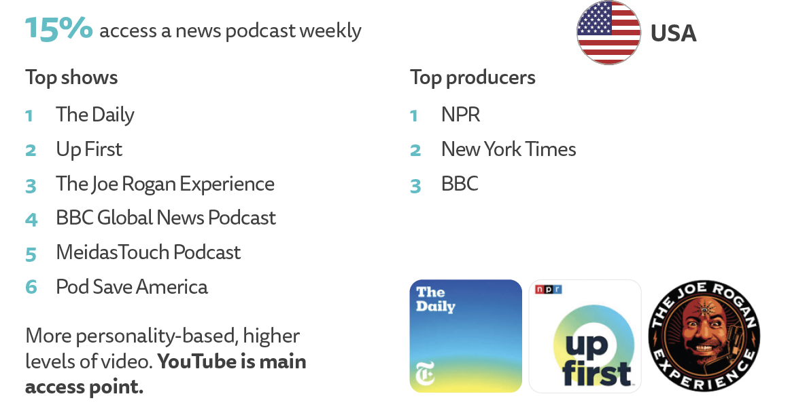
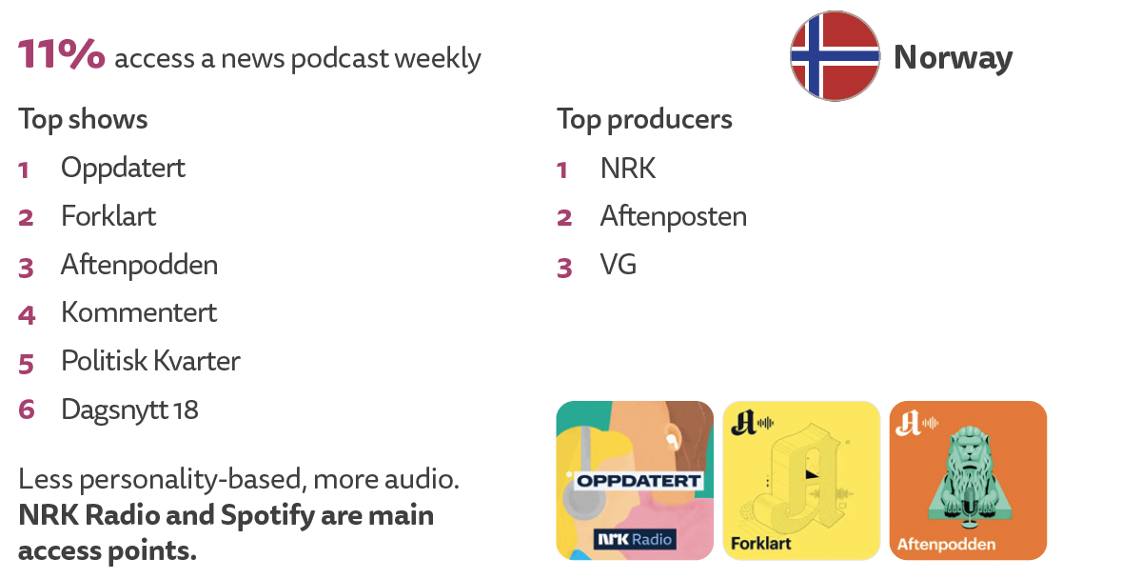
Many publishers have been investing in podcasts to reach younger, richer, news interested audiences
Video podcasts are a bigger part of the mix, especially in the United States
Most mentioned news and politics podcasts
Most mentioned news and politics podcasts
Q1_podcast_open. You said earlier that you have accessed a news-related podcast in the last week. Can you name those that you listen to most regularly? Base: News podcast listeners in USA = 304, UK = 153,
Notes:
In terms of podcasts we have seen a significant investment from publishers in the last few years – particularly in the United States as they chase that younger, richer audience – 15% say they consumed a news podcast in the last week. We also see
split between brand led traditional podcasts if you like such as the Daily and Up First and then personality led opinion podcasts like Joe Rogan and Meidas Touch , often video led because YouTube main access point.
In the UK much smaller proportion access news podcasts – most mentioned podcasts also personality led but tend to be more balanced, less partisan – most of them also available in video but the main listening is via audio platforms like BBC sonds and spotify

Slide 17
AI and the News
Notes:
So a final big theme is the emergence of AI as a source of news

Slide 18







Proportion that used each chatbot for news
7% say they use a chatbot for news weekly, much higher with under-25s (15%)
Norway is 4% for all, 18% under-25s
Notes:
This is hard to ask about in surveys because sometimes consumers aren’t aware that answers in Google overviews for example are generated by AI but overall 7% across markets say they have used a chatbot to access some kind of news – and this figure is twice as high with under 25s

Slide 19
AI will lead to more or less?
Audiences think AI will make news cheaper to make and more up to date but at the expense of accuracy, transparency and trust compared to news produced entirely by a human journalist
Net score (More – Less)
Notes:
In terms of what lies behind these levels of discomfort– we asked respondents how they felt AI would change the news – and across counties people feel it will make it cheaper to make and more up to date - but at the time less transparent, less accurate and less trustworthy – so potne4itally more opportunity for news organisations to emphasize those elements which we’ve already heard are super important to audiences

Slide 20
Paying for news
Notes:
Mimi first three, then Nic

Slide 21
Payment for online news – Selected markets
Very little growth in online subscriptions mostly within the margin of error. Norway and Sweden still lead –
small market, few strong brands that have loyalty across generations, lower platform impact
+5pp
+8pp
+4pp
Average shown across all ‘pay basket’ 20 markets
18%
Notes:
Firstly looking at levels of payment for online news across these 19 selected markets, we have seen no change in the average, at 18%.
Norway and Sweden remain as the top markets for paying for online news, with some markets seeing small changes compared to last wave, however just to flag that these changes are within the margin of error.

Slide 22

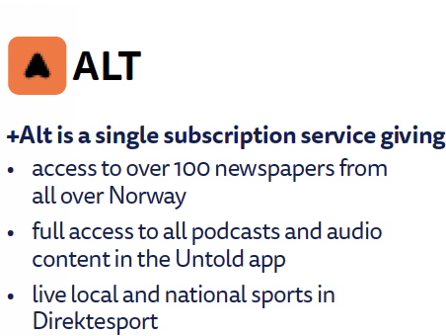
More people are taking up bundled offers in Norway
Norwegian bundled subscriptions over time
2023
2024
2025

Slide 23


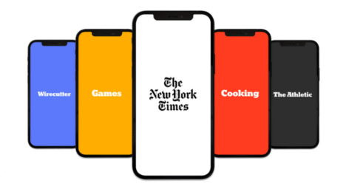
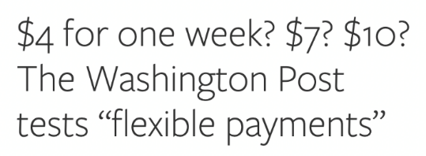


Could people who don’t currently pay be tempted by bundling or smaller, more flexible payments?
13% would be interested in getting access to more than one news provider
for a reasonable price
(e.g. local/national)
25% of nonpayers might be persuaded
by one of these
New York Times All Access
But…
7% would be interested in a bundle with additional services (sport, games etc.) along with the news
11% would be interested in paying for a day or a week (or an article)
59% would not be interested in any of these options
Notes:
Nc

Slide 24
Recap
Notes:
Mimi first three, then Nic

Slide 25



What does all this add up to?
Media losing influence in some countries as politicians tap into alternative personality led ecosystem that is gaining ground. How should news media respond to this trend?
Video and audio formats becoming more important, especially with younger audiences. How far should newsrooms shift away from text?
AI chatbots are starting to be used as a source of news. More with young people. How does this change the access model?

