Slide 1
Reuters Institute Digital News Report 2024
PREVIEW OF MAIN FINDINGS
Dr. Craig Robertson
Notes:
Run through some slides we can pick up things as we along and/or do it at the end. I’ve tried to hit the main points but after talking to Arun, I’ve tried to pick out some cases where emerging markets have different behaviours from developed ones, also to highlight different behaviour of younger people, and also devote a bit more time to the user need and content gaps that may exist in different countries and what they may do to close those gaps. unless we have time, I’m going to miss out the pay data but wanted to mention we have done work on how much people pay compared with the advertised price.

Slide 2
Representing half the world’s population
95,000
2
6
Respondents
+ Morocco
47
Continents
Markets
Notes:
This is our 13th Digital News report 12th supported by Google and the Google News Initiative and this year we cover 47 markets, largest ever with addition of Morocco. Every country has a page with data and commentary specific to that country though mainly looking at top level overview

Slide 3

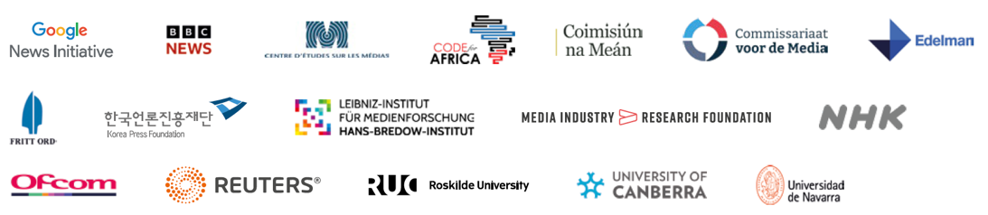




Online poll conducted between January/February 2024
Country | Sample Size | Population | Internet Penetration
Europe
UK | 2,017 | 68m | 95%
Austria | 2,015 | 9.1m | 88%
Belgium | 2,050 | 11.7m | 92%
Bulgaria | 2,027 | 6.9m | 70%
Croatia | 2,007 | 4m | 93%
Czech Republic | 2,009 | 10.7m | 87%
Denmark | 2,011 | 5.8m | 98%
Finland | 2,015 | 5.6m | 94%
France | 2,010 | 66m | 92%
Germany | 2,012 | 84m | 94%
Greece | 2,020 | 10.m | 79%
Hungary | 2,023 | 9.6m | 89%
Ireland | 2,034 | 5m | 92%
Italy | 2,015 | 60m | 91%
Netherlands | 2,037 | 17.m | 95%
Norway | 2,024 | 5.5m | 98%
Country | Sample Size | Population | Internet Penetration
Poland | 2,000 | 38m | 92%
Portugal | 2,012 | 10.m | 88%
Romania | 2,007 | 19m | 78%
Slovakia | 2,013 | 5.5m | 90%
Spain | 2,060 | 47m | 93%
Sweden | 2,018 | 10.m | 97%
Switzerland | 2,012 | 8.8m | 96%
Turkey | 2,082 | 86m | 85%
Americas
USA | 2,023 | 331m | 90%
Argentina | 2,023 | 46m | 91%
Brazil | 2,022 | 215m | 83%
Canada | 2,014 | 38m | 94%
Chile | 2,026 | 19.m | 97%
Colombia | 2,025 | 52m | 83%
Mexico | 2,030 | 131m | 67%
Peru | 2,013 | 34m | 87%
Country | Sample Size | Population | Internet Penetration
Asia Pacific
Australia | 2,003 | 26m | 90%
Hong Kong | 2,005 | 7.6m | 92%
India | 2,016 | 1,402m | 60%
Indonesia | 2,008 | 278m | 76%
Japan | 2,019 | 127m | 93%
Malaysia | 2,012 | 33m | 94%
Philippines | 2,014 | 112m | 91%
Singapore | 2,013 | 5.9m | 92%
South Korea | 2,015 | 51m | 97%
Taiwan | 2,011 | 24m | 95%
Thailand | 2,008 | 70m | 88%
Africa
Kenya | 2,043 | 56m | 85%
Morocco | 2,022 | 37m | 69%
Nigeria | 2,035 | 211m | 73%
South Africa | 2,013 | 60m | 58%
Main sponsor
Supported by
Spanish translation by
Surveyed by
Notes:
>>> A reminder of the methodology – which is based on online polling … and as such it will tend to underrepresent traditional news behaviours such as TV, print and radio when we talk about cross platform behaviour. Also important to stress that some of the markets especially in Africa and India are representative of younger more educated, English speaking groups so we try to bear in mind these differences
The survey was conducted on our behalf by YouGov on our behalf in January/early February 2024
This report is supported by 17 different organisations including main sponsor the Google News Initiative, BBC, NHK, media regulators, industry organisations and a number of academic institutions around the world. We are grateful to Reuters for their sponsorship and for hosting us here again today, also to Edelman who remain a long term and valued partner, and we welcome Code for Africa for the first time supporting our work in three African countries. I will now hand over to Nic Newman, lead author for a summary of some of the key findings

Slide 4
Platform Resets
Notes:
We’re seeing a lot of changes in platform strategies at the moment – partly linked to AI and greater competition but partly linked to changing audience behaviours and we are really starting to see this affecting the news industry in terms of both discovery and consumption ….
…

Slide 5








Further decline in Facebook, rise of video networks for news
Proportion that say that access each network for news weekly – average of 12 selected countries
Facebook algorithm changes, deprioritizes news
Also
Threads: 1%
Mastodon: 0%
Notes:
The most obvious example of this is with facebook where we see a significant decline for finding sharing or or consuming news - linked to strategy which has been less about investing in news and politics more about creators. This is aggregate data for social media and video platforms in 12 markets we have been following for some time. And then if we look at some of the other networks we see that all the growth is coming from video or visually led networks such as YT, Instagram and TikTok – and of course Facebook and X also leaning into video as well and prioritising formats designed to keep people within those platforms – so much harder to get the referrals. The other thing that is interesting about this chart is 10 years ago it was basically Facebook and YT but now consumption is much more fragmented – requiring publishers to have more focussed audience strategies .. So those are general trends heavily influenced by US and Western Europe but actually we find trends moving faster elsewhere

Slide 6
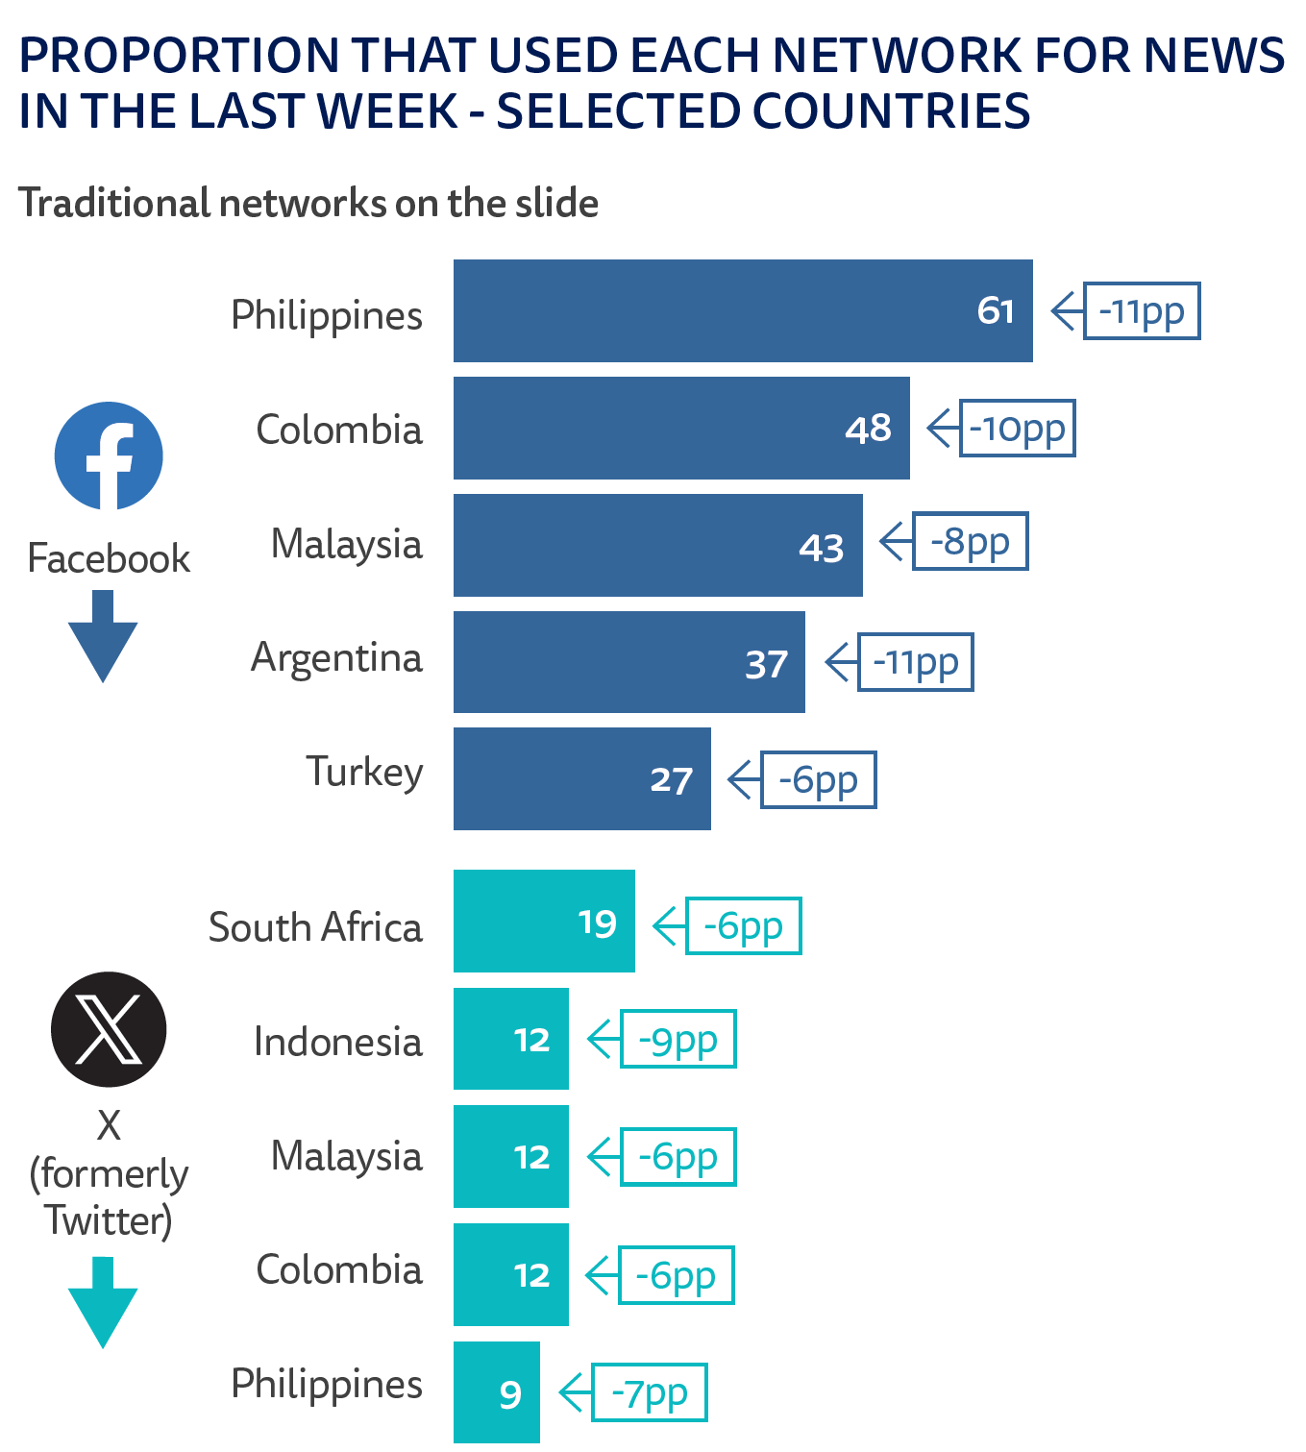
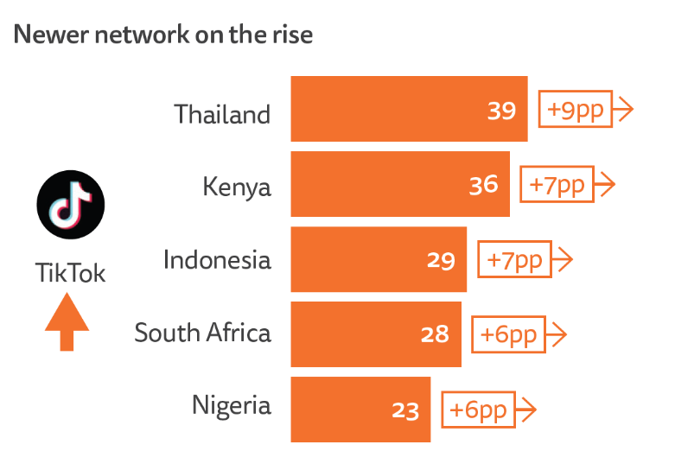

The platform mix is changing

Slide 7
Growing importance of video news
Notes:
This year we have done a deep dive into video news and into video platforms rise of short form and longer form streaming too

Slide 8





News video consumption is high across all formats
Audiences are twice as likely to consume short form video on daily basis, rather than live or long form. Consumption is much higher in the Global South than in many western countries .
Consume different news related videos weekly – average of all markets
High consumption countries …
Kenya
Nigeria
66%
51%
49%
+ under 35s
Thailand
South Africa
USA
Short form
Long form
Live news streams
Q11_video_2024. Thinking about when you have used online videos about news-related issues – e.g . via a computer, smartphone, or tablet – how often, if at all, do you watch the following? – Short online
news video(s) (a few minutes or less). Base: Total sample = 94,943.
Notes:
These are the numbers for weekly use across different formats – and the numbers are pretty suprising – 66% say they have accesed
Again more in the global south than in US and Europe though video consumption is very strng in the US
The daily figures are also

Slide 9

TikTok used for news more in global south
Darker colours represent higher levels of audience usage of TikTok for news. Grey indicates countries not covered or TikTok not operating.
3%
39%
UK
4%
US
9%
Thailand
39%
Morrocco
22%
Philippines
23%
Colombia
22%
Nigeria
23%
Kenya
36%
Peru
27%
Indonesia
29%
Overall:
Malaysia
31%
26% use TikTok for any purpose
13% use TikTok for news
South Africa
28%
Q12B. Which, if any, of the following have you used for news in the last week? Base: Total sample in each market ≈ 2000. Note: TikTok has been banned in India and does not operate in Hong Kong.
Notes:
Specifically if we look at the use of Tik Tok for news we see the fastest growth is in countries in the global south – for example more in both Kenya and Thailand more than a third now say they use TikTok for news – played significant role in elections in Argentina, Indonesia for example particularly with younger people – and just to compare that with news use in the UK and US we see much lower numbers though of course younger people here are also using it regularly.

Slide 10

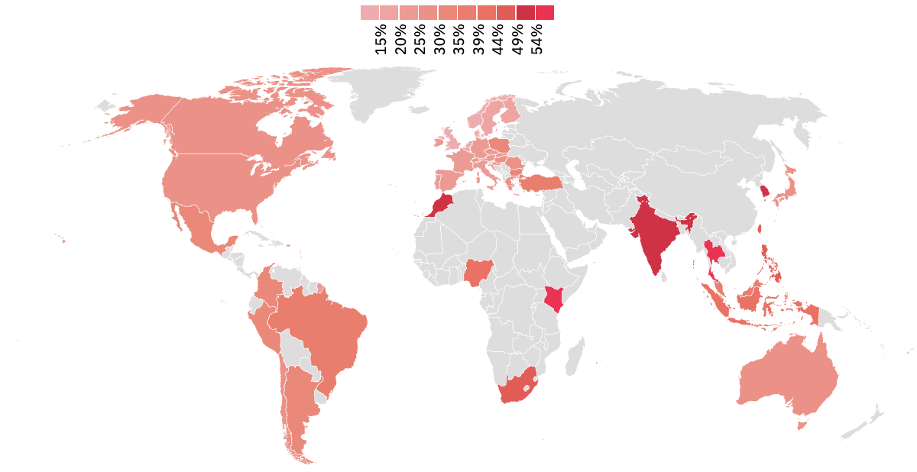
YouTube also important in much of global south
Redder colours represent higher levels of audience usage of YouTube for news. Grey indicates countries not covered
Finland
15%
UK
13%
India
51%
US
29%
Thailand
56%
Morrocco
50%
Hong Kong
51%
Nigeria
44%
Kenya
59%
Indonesia
41%
Peru
34%
Overall:
Brazil
38%
61% use YouTube for any purpose
31% use YouTube for news
South Africa
47%
Q12B. Which, if any, of the following have you used for news in the last week? Base: Total sample in each market ≈ 2000.
Notes:
If we look at You Tube consumption use for news which is much higher over 31% say they use for news up year on year – but again a similar pattern in terms of disproportionate importance in global south, least important in northern European countries and US, Brazil and other Latin American nations somewhere in the middle
And also with younger people

Slide 11

Which are the main platforms for video news by selected market?
In the last week, proportion of respondents who said each was their main platform for news video:
Equal platform, news brand preference
Notes:
Now when we look at the platform use by age, we start to see a lot more difference
This is particularly in the case of Instagram and TikTok (and to a slightly lesser extent, X) which show much more use amongst the under 35s compared to news websites and apps, these skew a lot more towards the O35s
Youtube and Facebook use seems to be more or less equal between the two age groups
Over to Nic

Slide 12
Which are the main platforms for video news by age?
All groups are more likely to watch via social or video network than via a news website 83% of under 35s say they use a third-party network most, 66% for over 35s
In the last week, proportion of respondents who said each was their main platform for news video:
Younger leaning
Older leaning
Notes:
Now when we look at the platform use by age, we start to see a lot more difference
This is particularly in the case of Instagram and TikTok (and to a slightly lesser extent, X) which show much more use amongst the under 35s compared to news websites and apps, these skew a lot more towards the O35s
Youtube and Facebook use seems to be more or less equal between the two age groups
Over to Nic

Slide 13
Worries about misinformation and unreliable content
Notes:
One of the biggest concerns that came out of the survey was around news avoidance and declining attention in general. Almost 60% reported that traffic had declined or stayed the same – though 40% said gone up so this is not a universal trend – more focussed on English speaking countries

Slide 14




Misinformation concern is up in many countries with elections
Amid concern about use of fake audio and video in social media
All Markets
59%
(+3)
…are concerned about what is real and what is fake on the internet.
United States
South Africa
India
72%
81%
58%
(+8)
(+6)
(+5)

Slide 15


AI generated fakes might make a difference
Fake images from Israel/Gaza conflict
AI GENERATED FAKE IMAGE
AI GENERATED FAKE IMAGE
“
I have seen many examples before, and they can sometimes be very good.
Thankfully, they are still pretty easy to detect but within five years they will be indistinguishable.
”
Male, 20, UK

Slide 16
Proportion of users that find it difficult to distinguish between trustworthy/untrustworthy news on each platform
Q6_platform_trust. Still thinking about trust, how easy or difficult is it for YOU to tell apart trustworthy versus untrustworthy news and information on each of the following platforms? Base: All those that used each platform (between 1000 and 1800 on average)
Notes:
27% said they had seen false or misleading information about the conflict in Israel and Palestine, this was a code added in 2024/
Politics remains the top with a 7pp increase.

Slide 17
AI and the News
Notes:
>>>>> Every year we ask respondents how they access news online – where they start their journey

Slide 18
Comfort with news organisations using AI in different scenarios
Much more comfort about using AI to help journalists as long as they stay in control. People in the US are more comfortable about mainly AI generated journalism than those in Europe
News produced mainly by AI with some human oversight
USA
EUROPE
News produced mainly by humans with some help from AI
“
USA
EUROPE
Notes:
In the survey we also asked how comfortable people were with two scenarios – so firstly where content is produced mainly by the AI with some human oversight – an example here might be AI bot that writes a story or a response – and in general what we see here is high levels of discomfort – a but more comfortable in the US than in Europe perhaps linked to higher awareness and usage in the US
And then the second scenario is where humans remain in charge of the content but AI is doing supporting tasks in the background – overall we see a different story here where in both US and Europe we see people more comfortable than uncomfortable – though also worth noting that there are a lot of people who don’t have an opinion – it is still very early days

Slide 19
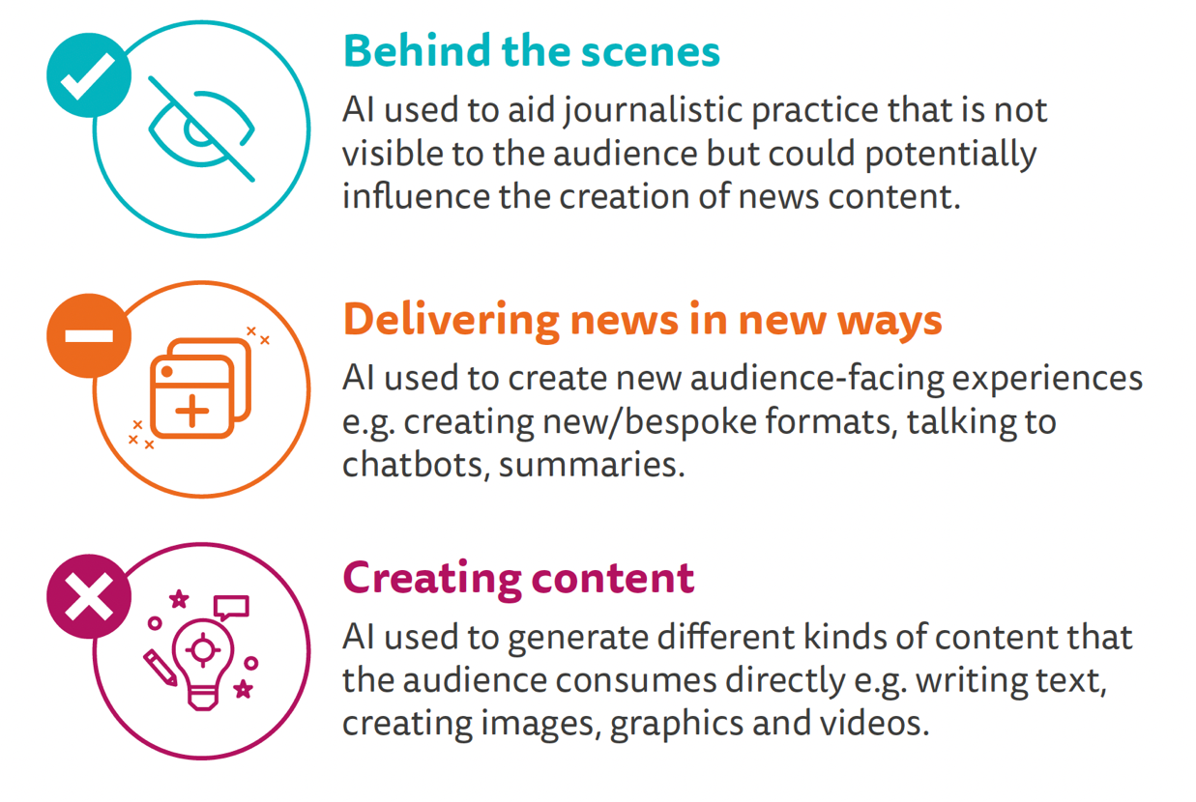
Comfort with news organisations using AI in different scenarios
More acceptance
Less acceptance

Slide 20
Proportion uncomfortable with AI producing content on the following subjects (albeit with human oversight)
People are much less comfortable with using AI on subjects that really matter such as politics and crime, and more comfortable with sports, arts or entertainment news
“
Chatbots really shouldn't be used for more important news like war or politics
”
Male, UK, 20
Less concern about soft news subjects
Notes:
We also asked about how comfortable people were with AI producing news (with human oversight) across different topics.
People have different comfort levels depending on the subject, showing the net uncomfortable for the US and UK here.
People are more uncomfortable with topics like politics and crime, and there is less discomfort when it comes to celebrity and sporting news.
The markets follow this same pattern, though the UK has higher levels

Slide 21
Trust in the news remains stable
40% trust most news
most of the time (average of 47 markets)
Notes:
So all this talk of AI brings us inevitable to the question of trust where headline figures have been declining in countries like the UK for some time, trust levels in individual brands as well – so this year we asked our respondents to tell us which factors were most important in defining which news outlet to trust

Slide 22





Decline in trust in some countries, but not all
Large declines in UK and Germany. Smaller dip in France.
US flat. Netherlands stable trust.
UK
Germany
France
US
Netherlands
+3pp
-15pp
-17pp
-7pp
2015 2024
2015 2024
2015 2024
2015 2024
2015 2024
Q1c. How interested, if at all, would you say you are in news? Net: Extremely/Very Base 2023; Spain: 2031, Italy: 2106, UK: 2107, Brazil: 2047, Germany: 2002, Finland: 2027, Czech Republic: 2047, Netherlands: 2022

Slide 23

Most important factors in defining whether a media outlet is trustworthy or not – ALL MARKETS
Transparent approach, lack of bias, high standards, and fairness are 4 primary factors driving trust. Issues of track record and over negative approach are secondary factors.
Accuracy, openness, fairness, lack of bias are key factors
Notes:
Drawing a comparison with the UK – similar scores proportionally
Standards and perceptions of bias a bit more important in the UK, and how negative an outlet is, or its track record plays a bigger role in the US

Slide 24

Most important factors in defining whether a media outlet is trustworthy or not – ALL MARKETS
Transparent approach, lack of bias, high standards, and fairness are 4 primary factors driving trust. Issues of track record and over negative approach are secondary factors.
‘How we did this’
Accuracy, openness, fairness, lack of bias are key factors
Notes:
Drawing a comparison with the UK – similar scores proportionally
Standards and perceptions of bias a bit more important in the UK, and how negative an outlet is, or its track record plays a bigger role in the US

Slide 25
Paying for news
Notes:
One of the biggest concerns that came out of the survey was around news avoidance and declining attention in general. Almost 60% reported that traffic had declined or stayed the same – though 40% said gone up so this is not a universal trend – more focussed on English speaking countries

Slide 26
Nordic countries lead in subscription, others some way behind
Still only a minority are prepared to pay for online news overall
17%
pay of online news, average of 20 markets
UNCHANGED FOR THREE YEARS
Notes:
Every year we track the proportion that say they pay for online news through subscription, membership or donation and if we look across 20 countries we can see. Adistinct slowing dwon of growth and in a few cases decline … Over a third are paying in Norway, Sweden , around a fifth in the United States but still much lower here in the United Kingdom – just 9% same as last year,
Overall average of these countries unchanged from last year at 17%
We have seen significant growth this year in Germany (up 5), Australia and Sweden but elsewhere seems to have levelled off with some declines too and the overall average of 17% is unchanged from last year.

Slide 27
Payment for any online news is levelling off …
Average payment across 20 countries has almost doubled since 2014 from 10% to 17%, …but has hit a ceiling in the last three years
3. Coronavirus
bumps
4. Levelling off, some increase, some decline
2. More/tighter paywalls
1. Pivot to paid content
2014
2015
2016
2017
2018
2019
2020
2021
2022
2023
2024
Notes:
Looking at these markets across time, the US has maintained levels after the dip last year with one in five paying.
Norway had a fall of 2pp this year (possibly connected with additional quotas)

Slide 28






Country differences in terms of paying full price
 | Country | Median cross-brand monthly price* | Median price in $USD** | Proportion paying less than full price for their subscription
 | Poland | 36.5zł | $9
 | USA | $16 USD | $16
 | UK | £11.50 | $14.50
 | Norway | 279 NOK | $25.50
 | Denmark | DKK 99 | $14
 | France | €12 | $13
78%
46%
41%
38%
25%
21%
Figures reflect what people say they pay for their online news subscription compared to the full asking price for that subscription. E.g., If a person says they are paying £10/pm for their subscription, but the full advertised price is actually £15/pm, they are considered as paying less than the full price.

Slide 29
The engagement challenge
Notes:
>>>>> Every year we ask respondents how they access news online – where they start their journey

Slide 30









Decline in interest in the news
Selected countries with largest falls
UK
France
Germany
United States
Singapore
-32pp
-23pp
-19pp
-15pp
-14pp
Selected countries with more stable levels
India
Norway
Sweden
Denmark
Finland
-12pp
-9pp
-2pp
-5pp
+1pp
2018
2024
Notes:
Looking at interest in news in general, these charts are a good example of how this has really fallen over time in some markets
Argentina, spain and the UK in particular seeing big declines since we began tracking
Conversely, the 5 markets below have remained relatively stable over time
Obviously we see fluctuation in the likes of south korea but overall from start to end there is nothing extreme
Only Germany at the moment is seeing the start of what could be a longer term downward trend

Slide 31
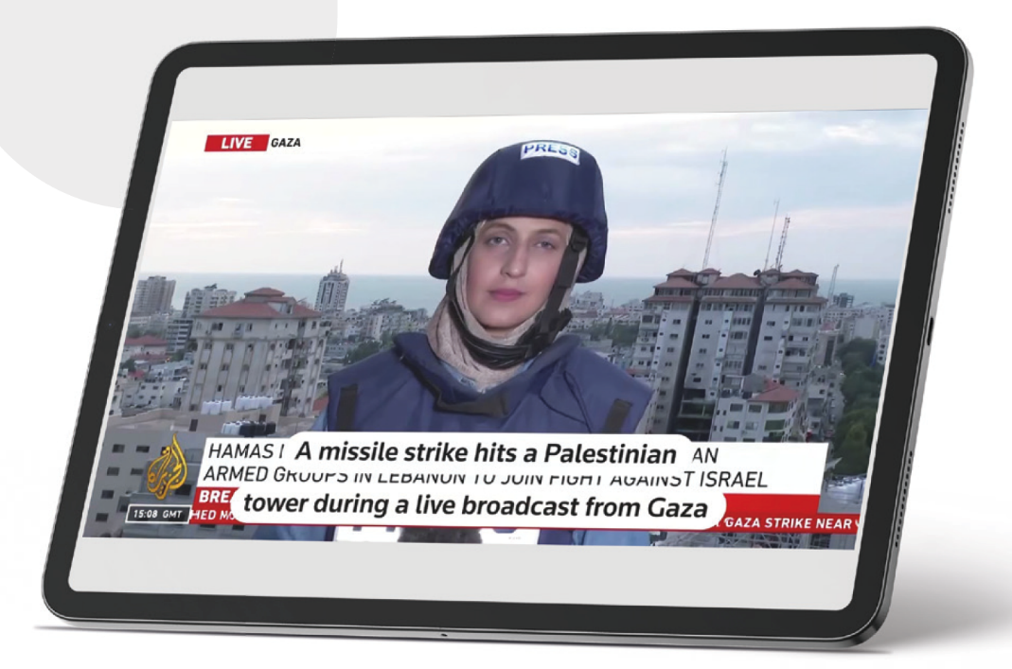
Selective news avoidance continues to grow …
“How are we supposed to function as a society, when all we see are the bad things in life?”
F, 28
39% (+3)
say they often or or sometimes avoid the news these days…
29%
Up from
in 2017
AVERAGE OF ALL MARKETS
Notes:
Related to this is the concepts of news avoidance and news fatigue – these are people who are consuming news and politics but selectively avoid it. Percentage that say they avoid sometimes or often pretty much doubled
And consistently they say they feel overwhelmed, the news is negative, there is nothing they can do about it,
here is young person avoiding news about politics, feeling her views not really taken into account, and then a young man worrying more generalyl about his mental health and the impact on his anxiety

Slide 32
User needs
Notes:
One of the biggest concerns that came out of the survey was around news avoidance and declining attention in general. Almost 60% reported that traffic had declined or stayed the same – though 40% said gone up so this is not a universal trend – more focussed on English speaking countries

Slide 33






User needs model as used by BBC News
+Help me
Updated and extended by a number of publishers to eight core needs
+Connect me
Keep me engaged
Inspire me
Update me
Divert me
Give me perspective
Educate me
Notes:
This is the model that people use
So we wanted to know how important each user need was, but also how well people feel that the media satisfies each of these needs.

Slide 34
Perceived importance of each user need – all markets
The most important user needs globally are around staying up to date, learning more, and gaining varied perspectives. This is pretty consistent across countries.
Proportion that think each user need is important
A bit more important to younger people
Update me
Educate me
Give me perspective
Notes:
So firstly access countries we find consistent hierarchy where people value both the updating function, the education function and providing a range of different perspectives on the news – younger people were a bit more likely to value news that made people better about the world that is inspire me and also connection – but mostly pretty similar of what the media should being doing

Slide 35
Perceived importance of each user need – all markets
The most important user needs globally are around staying up to date, learning more, and gaining varied perspectives. This is pretty consistent across countries.
Proportion that think each user need is important
Biggest gaps that audiences wanted news to fill
Give me perspective
Give me hope/optimism
Notes:
So firstly access countries we find consistent hierarchy where people value both the updating function, the education function and providing a range of different perspectives on the news – younger people were a bit more likely to value news that made people better about the world that is inspire me and also connection – but mostly pretty similar of what the media should being doing

Slide 36





Key findings summary…
Online platform reset:
Video formats on the rise:
AI & the news:
Subscription growth has stalled.
User needs:
Some platforms are withdrawing from news, others trying to keep traffic within their platforms.
Traffic to publishers likely to be more unpredictable with worries about impact of AI on search.
Both short and long form video is gaining popularity for news, especially with young and in global south.
General scepticism based on media narrative. Strong sense that humans must stay in control, especially around important subjects (politics, crime).
Worries about trust especially in TikTok and X
The majority are still not paying. Mostly people just subscribe to one news provider.
Half are not paying full price, suggesting heavy discounting and a problem of perceived value.
Media is considered to be doing a good job in updating people on latest news but less good at providing different perspectives or optimism.

Slide 37
Reuters Institute Digital News Report 2024
More at our website
digitalnewsreport/org
Notes:
I’m not going to go through the whole report – I’m going to pick out some key trends including the findings from industry survey that most of you filled in – and in going to focus on some of topics we’re going to cover in the breakout sessions – to help set some of those discussions up with some data and context

